Slide 1
Introduction Swarm Intelligence
Using What “Bugs” You

Slide 2
Central Behaviors
Evaluation
  Requires a solution representation
  Requires an evaluation function
Comparison
  Implies “neighborhood” organization
  Uses global knowledge eventually
Imitation
  Pressure to “improve”
  Probabilistic change

Slide 3
Key Elements of an Intelligent Swarm
A large number of “simple” processing elements
Neighborhood communication
Search can find any possible solution though no particular solution is assured in finite time

Slide 4
Swarm Simulation Pseudo-code
Initialize parameters
Initialize population
While (not done) loop over all individuals
  Find best so far
  Find best neighbor
  Update individual

Slide 5
Example: Task Assignment
Suppose P processors p ε {1, …,P} are to be assigned to T tasks t ε {1,…,T}
Assume that the rate r_{pt} is the rate at which processor p can perform task t
The rates r_{pt} can be collected in a PxT matrix R=[r_{pt}]
Let x_{pt} be a bit value such that x_{pt} = 1 if processor p is assigned task t, and x_{pt} = 0 otherwise
Assume P=T and that each processor will be assigned to exactly one process

Slide 6
Example: Task Assignment (cont’d)
Rates
 | t1 | t2 | t3 | t4
p1 | 9 | 5 | 7 | 9
p2 | 5 | 1 | 3 | 8
p3 | 8 | 7 | 6 | 5
p4 | 3 | 6 | 4 | 7
Assignment (value=25)
 | t1 | t2 | t3 | t4
p1 | 0 | 1 | 0 | 0
p2 | 0 | 0 | 0 | 1
p3 | 1 | 0 | 0 | 0
p4 | 0 | 0 | 1 | 0

Slide 7
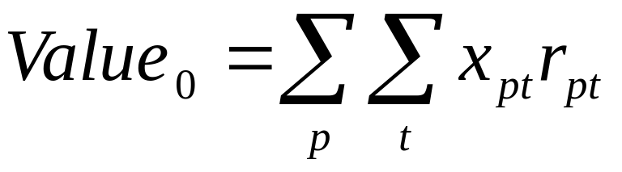
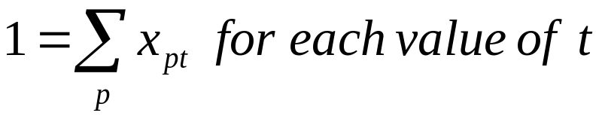
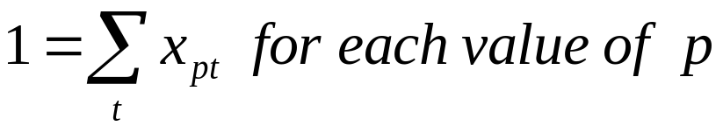
Example: Task Assignment (cont’d)
Evaluation Equation (to be maximized)
With constraints

Slide 8
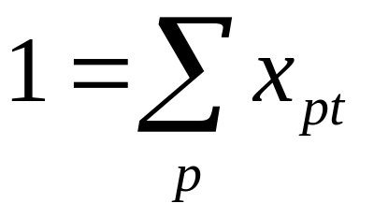
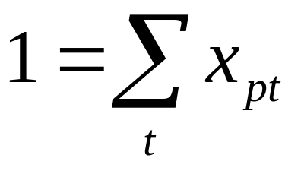
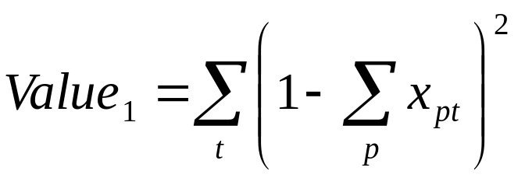
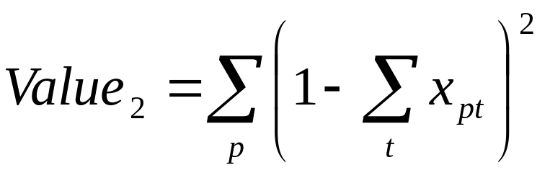
Example: Task Assignment (cont’d)
Incorporate constraints (for each p and t, respectively)
into the objective using

Slide 9
Example: Task Assignment (cont’d)
The objective then becomes to maximize
Value = Value₀ – Value₁ – Value₂

Slide 10
Representing A Solution
Assignment (value=25)
 | t1 | t2 | t3 | t4
p1 | 0 | 1 | 0 | 0
p2 | 0 | 0 | 0 | 1
p3 | 1 | 0 | 0 | 0
p4 | 0 | 0 | 1 | 0
A solution can be represented as using an array of bits, e.g.,
0100
0001
1000
0010
or as a bit string
0100000110000010

Slide 11
Finding New Solutions: Notation
Each bit represents a dimension d of a bug’s solution and let
  x_{id}(t) represent the state of bit d in “bug” i at time t
  p_{id} represent the state of bit d for the best solution found so far by “bug” i
  p_{gd} represent the state of bit d in the best solution found so far among the neighbors of “bug” i

Slide 12
Finding New Solutions (cont’d)
v_{id}(t) represents the propensity of bit d in “bug” i to change at time t
  Larger values of v_{id} favor choosing x_{id}=1
  Smaller values of v_{id} favor choosing x_{id}=0
ρ_{id} represents a random value drawn uniformly from the interval [0.0, 1.0), when updating the state of bit d for “bug” i

Slide 13
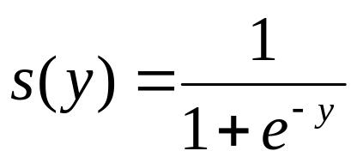
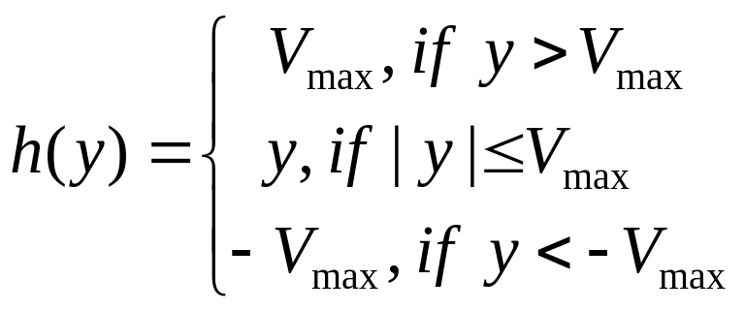
Two Useful Functions
Use a sigmoid function
whose range is the open interval (0, 1)
Use a piece-wise linear function
whose range is the closed interval
[-Vmax, Vmax]

Slide 14
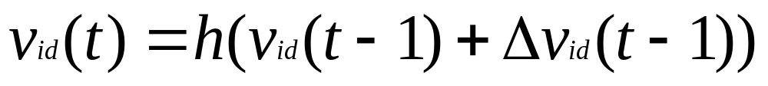
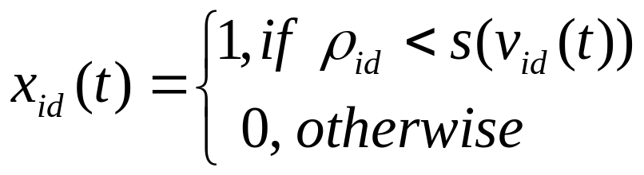
Updating Each “Bug” In The Swarm
Obtain the change in v_{id}
Calculate to new propensity to change
Update dimension d of “bug” i

Slide 15
Parameters φ₁ and φ₂
Initially, choose φ₁ and φ₂ from a nonnegative, uniform random distribution with its upper limit = 2
In pseudo-code, φ = 2 * arandom
After you develop an intuition (=garner some intelligence) about the effects of the φ values, explore the effects of changing these limits

Slide 16
A Basic Swarm Algorithm
Initialize
Repeat for each “bug” until termination criteria are met
  Evaluate current solution
  Record if better than individual best so far
  Find best solution in the neighborhood
  Update current solution

